Slide 1
Disability
Programs and devices enabling to overcome it

Slide 2
Table of Contents:
Disability today
Our duty is to help
Devices:
Auto-Lektor
SmartNav AT
Enlarger Prisma AF
Programs:
Brajl 5.0
Camera Mouse
Spikit

Slide 3
Disability today
In the age of technological progress computer and Internet network
became an important part of everyday life without which we almost
cannot imagine our work, leisure of even life.
However it is difficult for common use as there are many people
whose contact with such a things like computer or Cyberspace is hardly limited, difficult or even impossible.

Slide 4
Our duty is to help !
There are many technical solutions that face the problems of disabled people. Professional electronic devices give them a chance to work as the other people. Many facilities help people with cerebral palsy, multiple sclerosis, partially or completely paralyzed, after amputations and with sight defect.
…both of them have got wheels
Employers! Do not be scared of disabled employees.

Slide 5
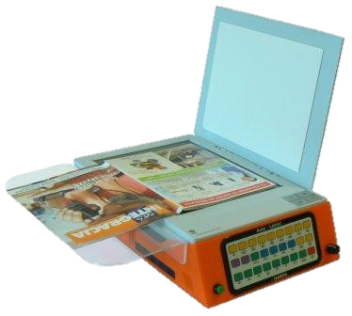
Auto-Lektor
Reads any printed text
Connection to the Internet
Suitable for people who don’t know much about computers
Easy to operate and move
http://www.harpo.com.pl/index.php?prtlid=1097&art_id=127

Slide 6
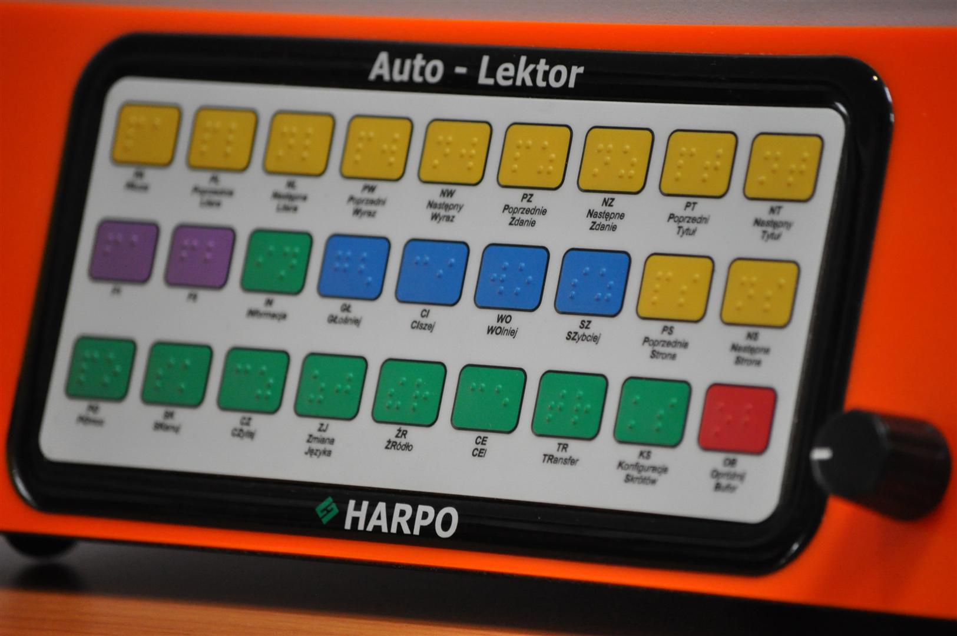
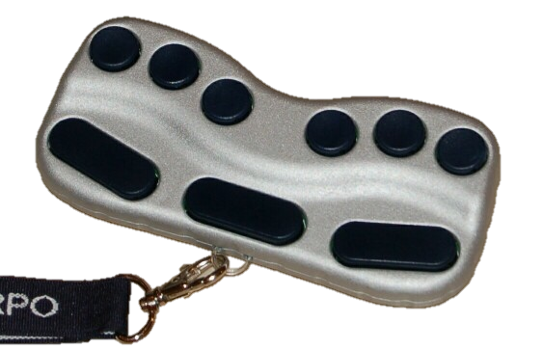
Auto-Lektor
PRICE: 2400 €

Slide 7
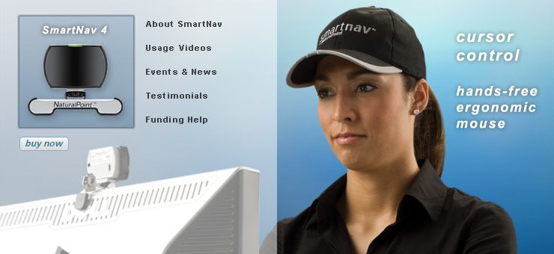
SmartNav AT
Moving the mouse via moving user’s head
Socket for clicking devices
Includes WordWall – onscreen keyboard
Possibility to use Word or Outlook

Slide 8
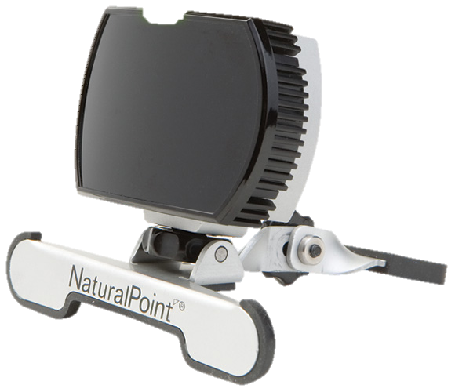
SmartNav AT
PRICE: 500 €
http://www.harpo.com.pl/index.php?prtlid=1098&kat_id=164&art_id=268

Slide 9
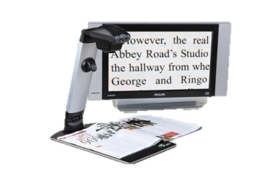
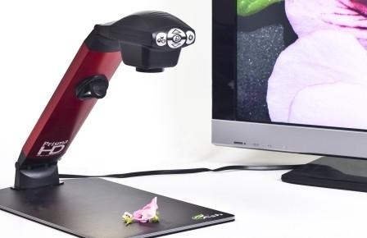
Enlarger Prisma AF
Comfortable watching of enlarged materials
Easy and uncomplicated in use
Auto-Focus function
Able to connect with tv set or computer
Mobile device

Slide 10
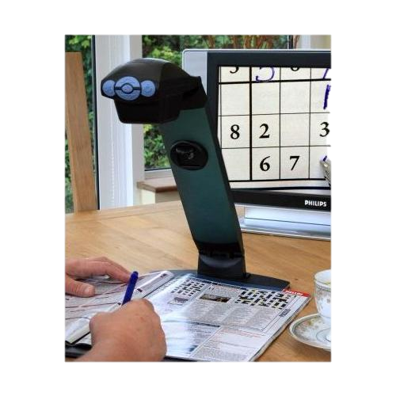
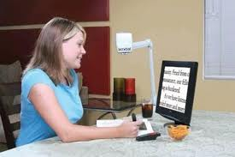
Enlarger Prisma AF
PRICE: 1650 €
http://www.harpo.com.pl/index.php?prtlid=1097&kat_id=128&art_id=601

Slide 11
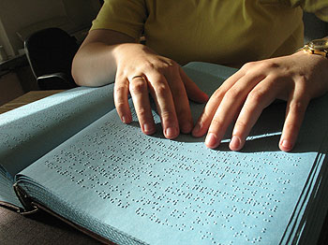
Brajl 5.0
Composing and printing text in Braille’s writings
Works with ordinary, mathematical and computer text
Generes a table of contents and numbers pages to print
PRICE: 200 €
http://www.sklep.altix.pl/str,prod_big,idk,370,kat,67,Brajl_5_0.html

Slide 12
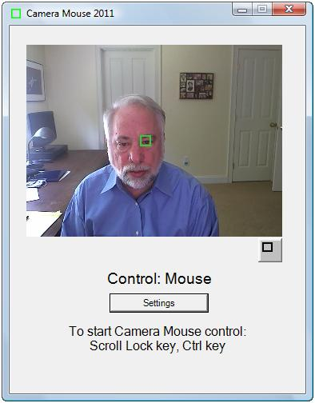
Camera Mouse
Avaiable for free downloading
Allows to control the mouse point by moving user’s head

Slide 13
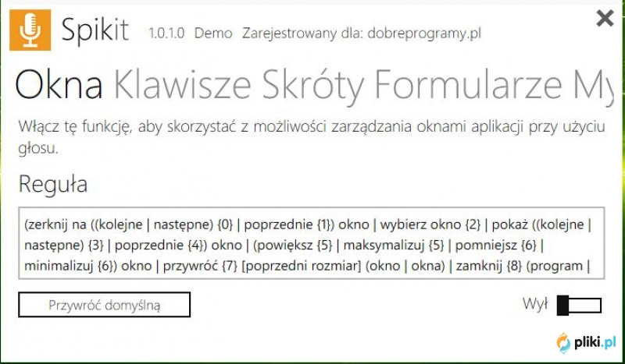
Spikit
Widely simplification of everyday work with computer.
Operating system service from Windows, and software by speech
It’s possible to adapt Spikit to do very demanding tasks.

Slide 14
The END
We would like to invite you for a short presentation of programs:
Spikit
Camera Mouse.
Thank you for your attention
Bartosz Płaneta
Martyna Pietraszek

